Slide 1

Vehicle
Rental System

Slide 2

Students name
NAME : HIRANI PRIYA RAMESHCHANDRA.
ROLL NO : 150
ENROLLMENT NO : 23002170110049
BATCH : D-5
BRANCH : CE
NAME : SHAH VIDISHA KIRAN.
ROLL NO : 123
ENROLLMENT NO : 23002170310012
BATCH : D-5
BRANCH : CSD
NAME : KAPADIYA PRIYAM M.
ROLL NO : 149
ENROLLMENT NO : 23002170110064
BATCH : D-5
BRANCH : CE
NAME : SHAH ARYA NIRAV.
ROLL NO : 145
ENROLLMENT NO : 23002170210117
BATCH : D-5
BRANCH : IT
NAME :GOYANI KHILAN SANJAYBHAI.
ROLL NO : 139
ENROLLMENT NO : 23002170110047
BATCH : D-5
BRANCH : CE

Slide 3
Project Outline :
Purpose of the project
ER diagram
Class diagram
Use case Diagram
System design diagram (Flow-chart)
Functionalities
Used DATA Structures and class
Any used Triggers and procedures
Tools used
Merits & Demerits

Slide 4
Purpose of the project
Enhances customer experience with online booking and flexible payments.
Automates processes and optimizes costs.
Supports scalability and manages customer relationships.
Provides reporting and analytics for data-driven decisions.

Slide 5
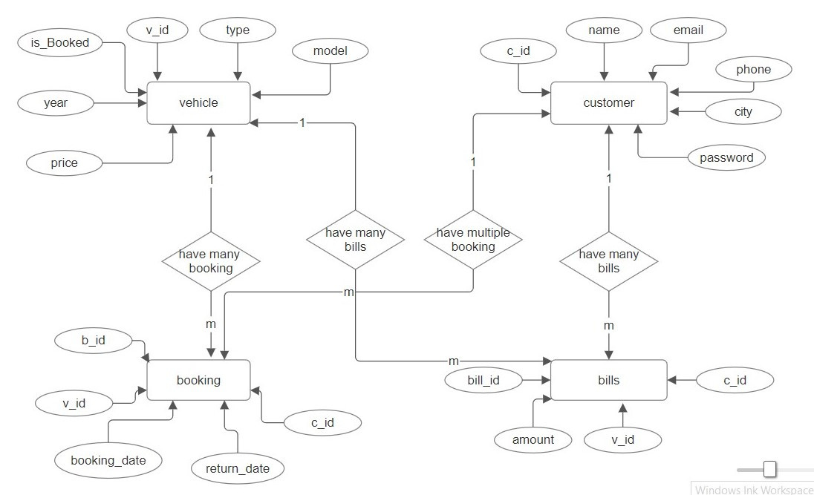
ER diagram

Slide 6
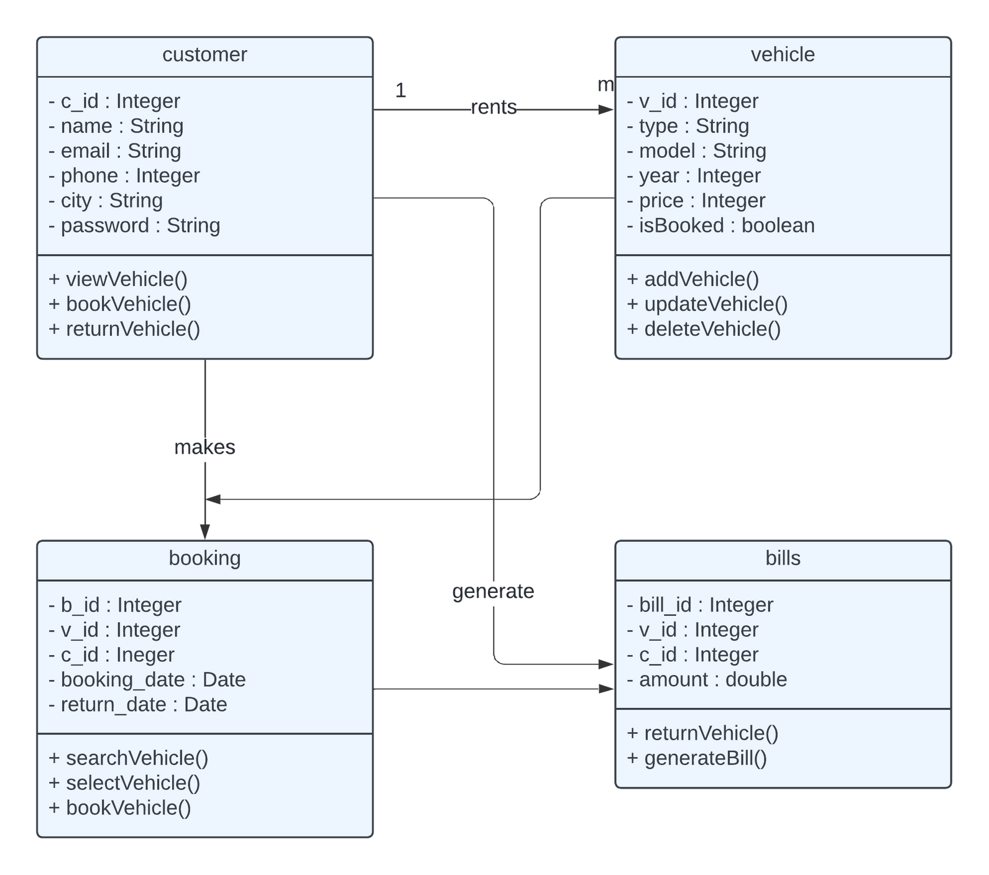
+ public
- private
# protected
~ package
Class diagram

Slide 7
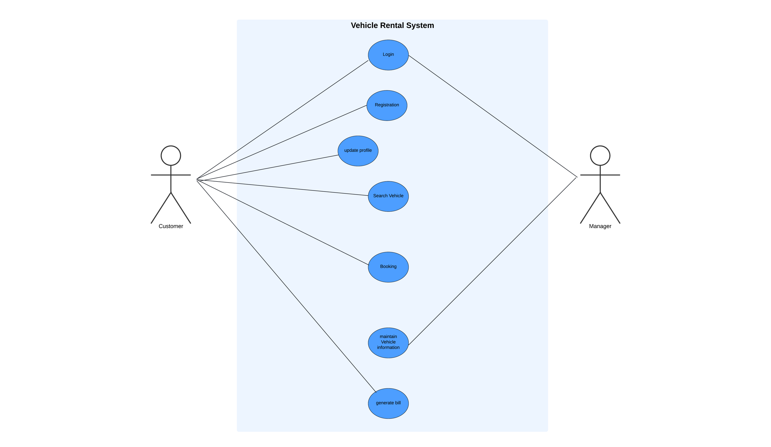
Use case Diagram

Slide 8
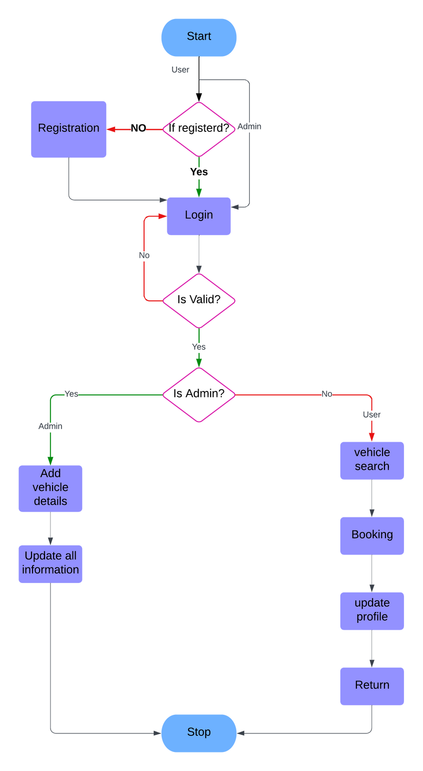
Flow-chart

Slide 9
Functionalities of project
Related with Particular Subject
Data Structures using JAVA | JAVA - II | DATABASE MANAGEMENT
Data structures like linked lists store and retrieve vehicle and customer information quickly. | 1. Exceptional Handling in Customer and Vehicle Database | 1.DML Quries for Customer & vehicle.
2. Update vehicle data using LinkedList. | 2. jdbc use for connection | 2.DDL Quries for Customer & vehicle.

Slide 10
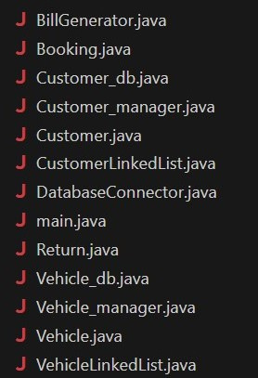
Used DATA Structures and class
LinkedList
Classes :

Slide 11
SQL Table and procedures
Procedure :
calculate_rental_days(bookingId,b_date,r_date)
IN parameter - book_id
OUT parameters - b_date & r_date
Tables :
vehicle(v_id int,type varchar,model varchar,year int,price int,isBooked boolean)
customer(c_id int,name varchar,email varchar,phone varchar,city varchar,password varchar)
booking(b_id A.I. int,v_id int,c_id int,booking_date date,return_date date)
bills(bill_id A.I. int,v_id int,c_id int,amount double)

Slide 12





Tools used
Visual Studio
XAMPP Control Panel v3.3.0
Chrome Browser
mysql-connector-j-9.0.0

Slide 13
Merits & Demerits
Merits
Demerits
Convenience : Flexible vehicle choices and easy online booking.
Cost Savings : No maintenance or long-term ownership costs.
Travel Freedom : Plan trips without relying on public transport schedules.
Limited Options: Small selection of vehicle types and models.

Slide 14
Thank
You.

